Slide 1
TIC TAC TOE USING SOCKET PROGRAMMING
GANDIVALASA KEERTHI TEJ
- AM.EN.U4AIE20027
KALLA YADHU VAMSI
- AM.EN.U4AIE20039
PONNURU SATHWIK VENKATA GOWTHAM
- AM.EN.U4AIE20064
GROUP 7A

Slide 2
TABLE OF CONTENTS
01
04
INTRODUCTION
RESULTS
02
05
GAME CONDITIONS
OBSERVATION
03
06
METHODOLOGY
CONCLUSION
07
REFERENCES

Slide 3

INTRODUCTION
01

Slide 4
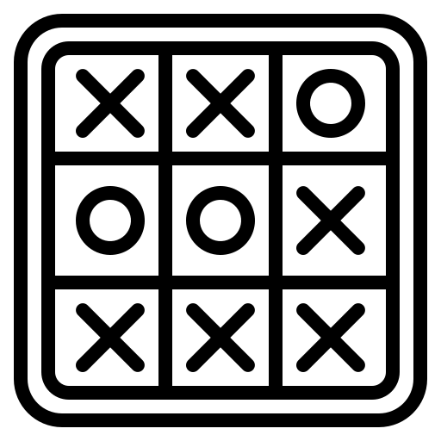
INTRODUCTION
Tic-tac-toe is a simple, two-player game that, if played optimally by both players, will always result in a tie. The game is also called noughts and crosses or Xs and Os.
Tic-tac-toe is a game that is traditionally played by being drawn on paper, and it can be played on a computer or in different devices.
Tic Tac Toe is a game for two players selecting ‘O ‘ or ‘X’ in pos.
They take turns marking the spaces in the 3 x 3 grid.
The player who succeeds in placing three successive marks either in horizontal, diagonal or vertical wins the game.

Slide 5

SOCKET PROGRAMMING
A Socket is used in a client-server application framework. A server is a process that performs some functions on request from a client.
Most of the application-level protocols like FTP, SMTP, and POP3 make use of sockets to establish connection between client and server and then for exchanging data.
Sockets allow communication between two different processes on the same or different machines.

Slide 6
TYPES OF SOCKET PROGRAMMING
Stream Sockets : Delivery in a networked environment is guaranteed. These sockets use TCP for data transmission. If delivery is impossible, the sender receives an error indicator.
Datagram Sockets : Delivery in a networked environment is not guaranteed. They're connectionless because you don't need to have an open connection as in Stream Sockets. They use UDP.
Raw Sockets : These provide users access to the underlying communication protocols, which support socket abstractions. These sockets are normally datagram oriented.
Sequenced Packed Sockets: They are similar to a stream socket, with the exception that record boundaries are preserved. This interface is provided only as a part of the Network Systems (NS) socket.

Slide 7
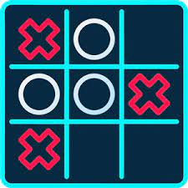
OVERVIEW
Tic Tac Toe is a simple game that flexes the basic concepts in programming. For example, a Tic Tac Toe program requires data structures for storing the board and conditional logic for knowing whose turn it is or if someone has won.
Tic Tac Toe's simple rules are very easy to decompose into small, discrete functions that we can put together to create a complete game. This process of decomposition and synthesis, breaking something down and putting it back together, is absolutely essential to programming.

Slide 8
GAME CONDITIONS
02

Slide 9
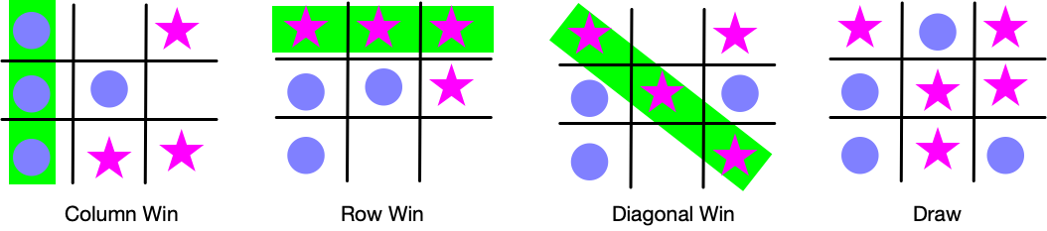
GAME CONDITIONS
The game is played between two players each of whom select their respective symbols to mark.
Player one starts the game by placing his or her symbol in any of the nine squares.
Player two marks the turn by placing his or her symbol in the empty square.
Both players make their turns alternatively.
The player who gets three respective symbols either in horizontal vertical or diagonal wins the game.

Slide 10
METHODOLOGY
03

Slide 11
METHODOLOGY
Server:
The game server listens for and accepts clients connections. The server mainly acts as a forwarder by transmitting the data between the Players.
The server doesn't do any logic — such as executing game rule, coordinating player’s turn and computing scores because we have handled those at the client application for improved communication efficiency.
We are defining a function for taking input of the Player 1 and Player 2 respectively.
We are defining another three functions to check the rows, columns and diagonals in the given matrix.

Slide 12
We are also naming another function to know whether the player who won or the player got lost. Also Starting a server which gives us a connection to bind to port.
We must make sure the players are connected through the Host IP Address and port number.
We also created a function which starts the game and allows the players to give input alternatively.
It displays the common messages to the players whether the game has been drawn, won or lost.

Slide 13
METHODOLOGY
Client:
The Tic-Tac-Toe game client application provides an intuitive user interface for connecting to the server and playing the game.
Initially a connect "frame" is opened where a player enters the name and connects to the server. After connecting, the connect frame is hidden and the main game window is displayed.
We already defined the default colour for each individual player and an empty matrix. We are creating a thread function to run multiple thread at a time.
Before defining Build Screen, we’re defining display variables like width and heights in a window terminal.

Slide 14
The Center Message function will decide the choice to select the block in the display grid and colour respectively. We also defined another two functions to print the current player’s turn and their current matrix.
Validate input function checks the input whether it is valid or not. Handle Mouse Event function allows the player to give input through the cursor.
We define another function AcceptMsgs, In this function we are using encode and decode methods to process data between players and server.
Start Game function takes the information from AcceptMsgs function and checks the status of pygame and starts the game.

Slide 15
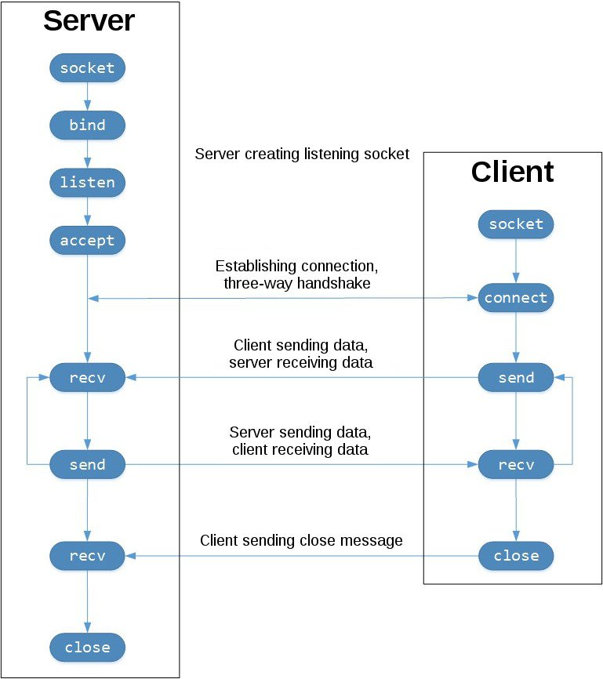
TCP WORK FLOW

Slide 16
RESULTS
04

Slide 17
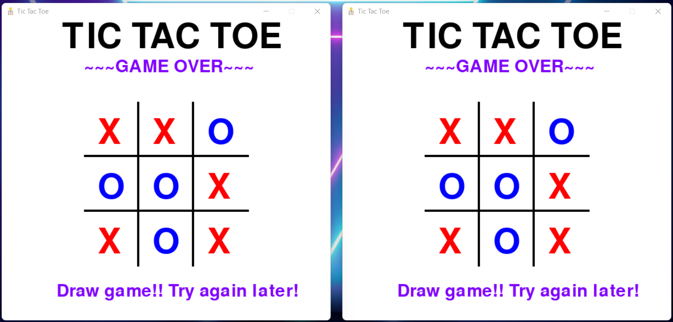
RESULTS
Game is tied

Slide 18
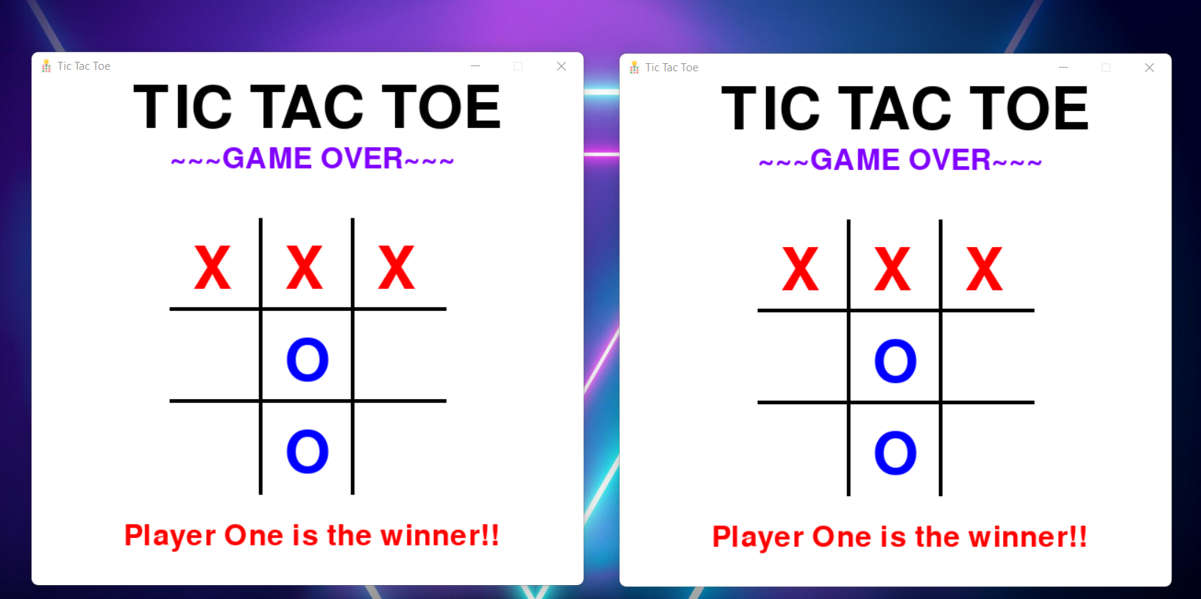
RESULTS
When Player 1 wins

Slide 19
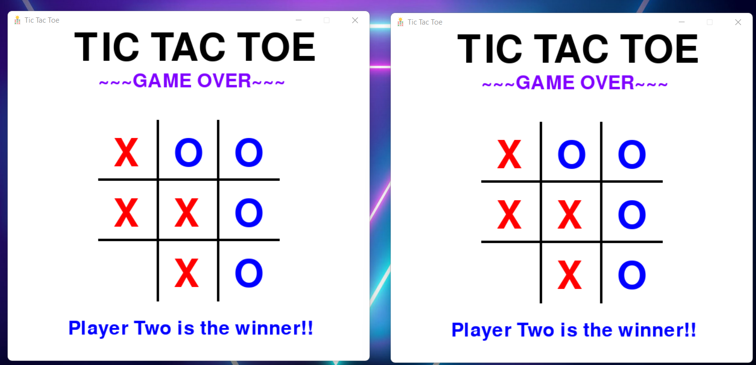
RESULTS
When Player 2 wins

Slide 20
OBSERVATION
05

Slide 21
OBSERVATION
We basically run the server code in another device and client code in other device. The server demands the IP Address from the client.
After giving the IP address to the server, it waits for another peer to join. One player should run only client code whereas the other should run both server code and client code.
After it accepts the connection, both players can play according to their turns respectively. Who strikes the row, column or diagonal first wins.

Slide 22
CONCLUSION
06

Slide 23
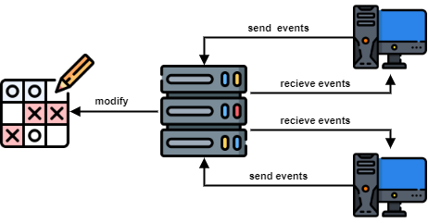
CONCLUSION
Our concept of work shows you how to create a turn-based network game in Python by implementing a network version of the Tic-tac-toe classic game.
It covers important principles, concepts, and best practices for creating an effective network games.
Our game Tic-Tac-Toe uses TCP.
We have limited the board size to 3x3 in order to keep things simple. However, the tic-tac-toe game can also be played on larger board sizes.

Slide 24
REFERENCES
07

Slide 25
REFERENCES
[1] D. B. Kiitsner and B. P. Clemens, "Electronic tictac-toe game having three function control," ed: Google Patents, 2003.
[2] P. Turner, "Combination tic-tac-toe and question and answer game," ed: Google Patents, 1987.
E. Kaplan, "Interactive tic-tac-toe slot machine," ed: Google Patents, 1999.
[3] S. C. Raphael, A. S. Raphael, and R. R. King, "Three-dimensional tic-tac-toe game," ed: Google Patents, 1995.
[4] P. R. Anderson, J. D. Flint, J. J. Giobbi, S. P. Joshi, and E. A. Frohm, "Gaming machine with pattern-driven bonus array," ed: Google Patents, 2005.

Slide 26
THANK YOU!

